Slide 1
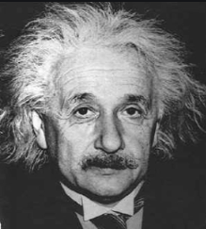

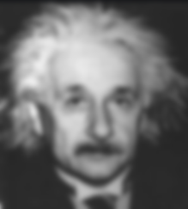

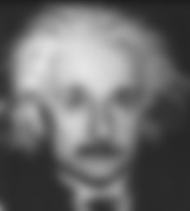
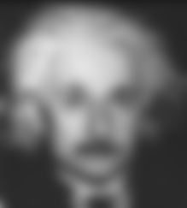

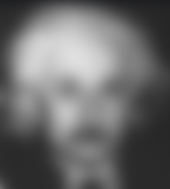

“Privatizing” Image Datasets
Project presentation for course:
Foundation of Data Privacy, 67508 HUJI
Roei Yehuda
Roy Friedman
Hadar Mulian
Notes:
אז בגדול הפרויקט שלנו מתעסק בוויז'ן – בהפרטה (?) של תמונות וננסה בחצי שעה הקרובה קצת ללמד אתכם מה זה אומר, איך אפשר לעשות את זה ומה היינו רוצים לקבל כדי להגיד שהצלחנו במשימה
Roei
Hi everyone, Hadar Roei and I, Roei, chose to play around with images in our project. Our project’s title is ‘Privatizing Image datasets’ and it’s a practical, curiosity-driven project.

Slide 2
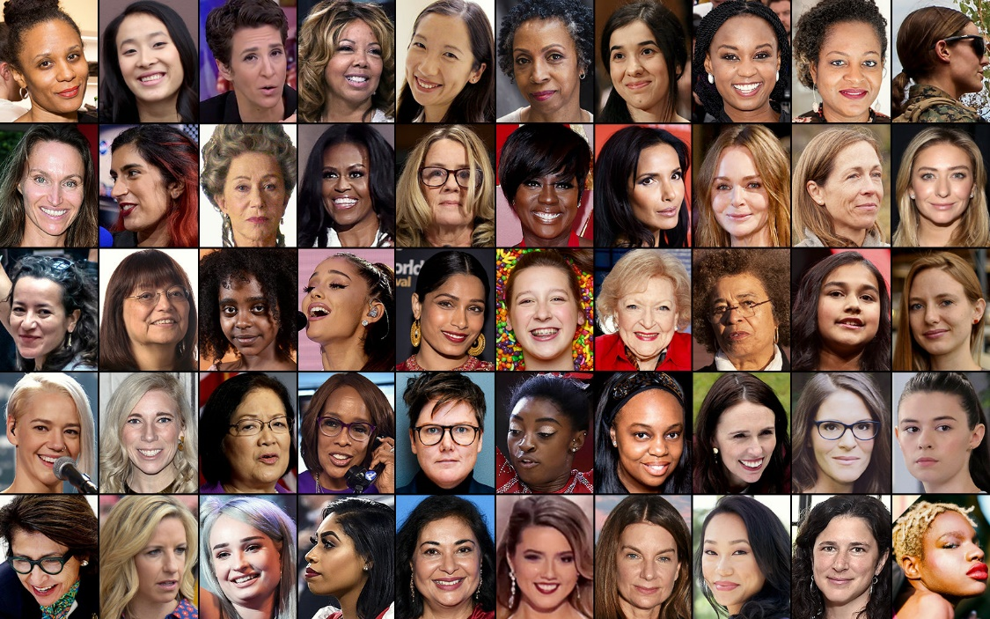

Motivation and Goals
What does “privatizing” an image dataset mean?
How should we apply noise to the images?
Notes:
Roei
First off, what does privatizing images mean? Well, this is context-dependent.
In our framework, we have an image dataset of some type, where each image has an identity behind it. For instance a cats dataset, or perhaps the most canonical example would be a portraits dataset. So, privatizing the dataset means publishing a new dataset with similar properties but where the people identities can no longer be recognized by an adversary.
We could try and formalize it just a little bit – Our dataset X = {x_i}^n are images and each x_i has an identity y_i. Privatizing the dataset X means creating a new dataset X’={x’_i} that is similar to X (X~X’) but the identities cannot be recognized.
To create X’ we need to find the right way to add noise to the images.
The basic naïve approach is adding noise in the pixel space.

Slide 3


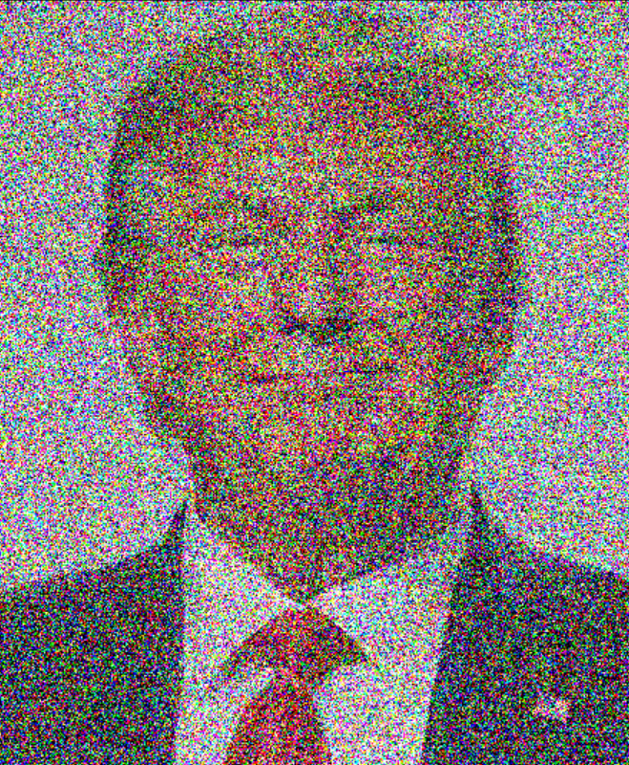
Noising Pixels
Notes:
Roei
Here we have a couple of examples of noise in the pixel space – on the left is the original image of Trump, the image in the middle was blurred and on the right we added Gaussian noise. Adding noise in the pixel space means we add noise to every pixel independently of others.
As you can see here, adding noise in the pixel space, even a substantial amount of it, doesn’t obscure the identity of the subject.
Also, denoising images in the pixel space has been a main interest in vision and we are very good at it.
So perhaps, a better approach would be to manipulate the features of the subject, rather than the pixels of the image.

Slide 4

Noising Features, Not Pixels
Notes:
Roei
Here we have a small dataset of smiley faces. Each is a 50*50 image, that is 2.5K pixels, and that sounds like a lot of data per smiley, right? I mean, it’s easy to see you could represent a smiley with a shorter set of parameters. What do you think, for instance, are the key features of every smiley?

Slide 5
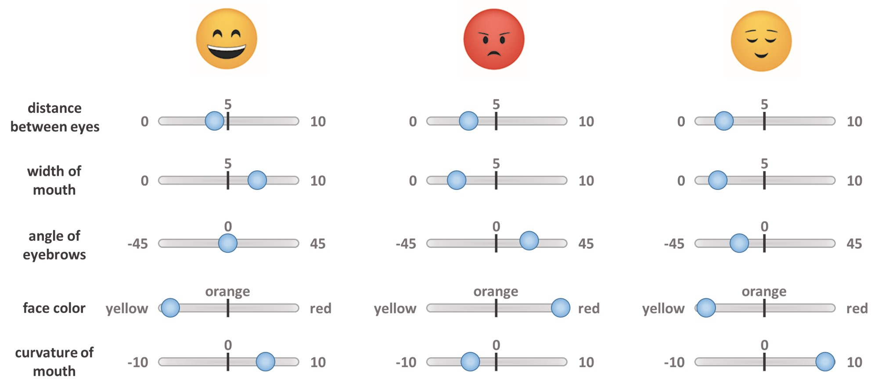
Noising Features, Not Pixels
Notes:
That is, for each smiley s_i in R^2500 there is some z_i in R^d, where d is very small, and this is a a smaller, more compact and concise representation of smileys..
And if we have some way of going back and forth s_i ←→ z_i if we have this mapping, so
by altering these features we can manipulate these smileys or basically generate new ones.

Slide 6
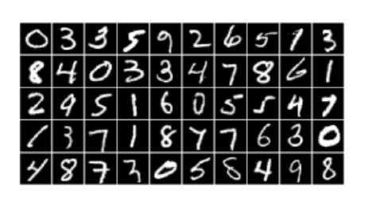
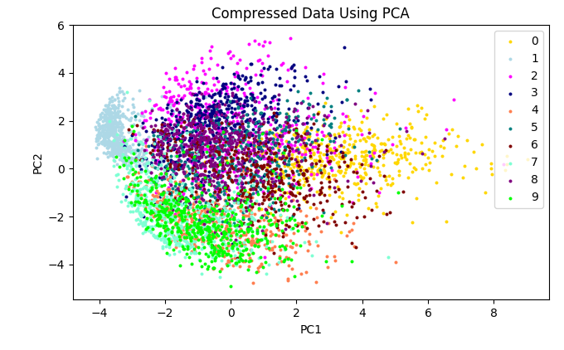
intro2PCA
Notes:
על מנת להבין אוטואנקודרים נתחיל בדוגמא פשוטה יותר כדי להמחיש את העניין – PCA.
תמונה 1 כאן
Roy

Slide 7
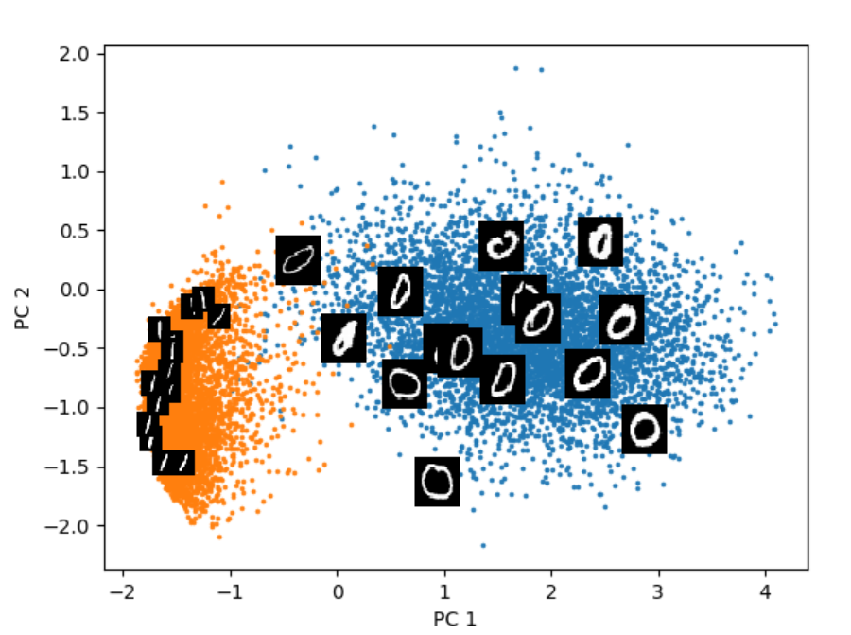
intro2PCA
Notes:
על מנת להבין אוטואנקודרים נתחיל בדוגמא פשוטה יותר כדי להמחיש את העניין – PCA.
תמונה 1 כאן
Roy

Slide 8
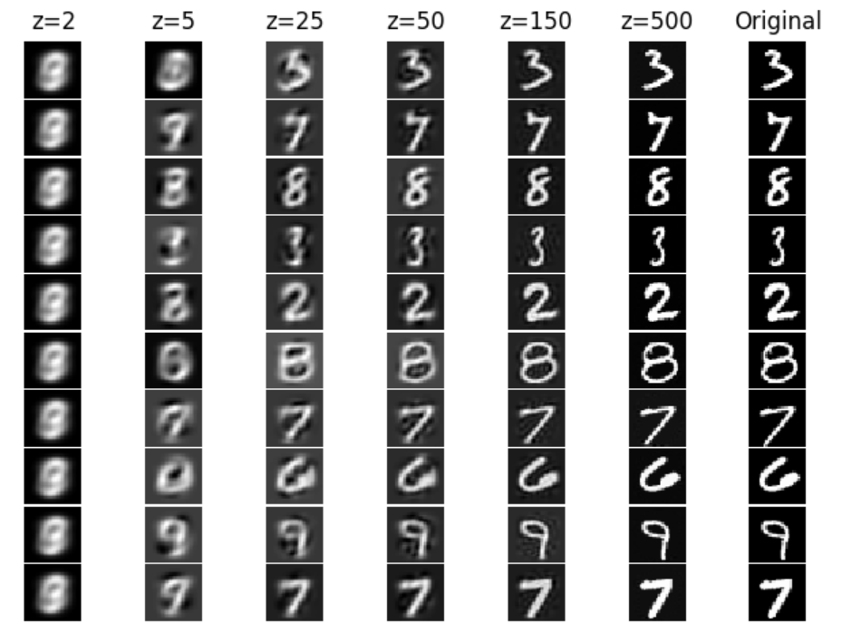
intro2PCA
Notes:
Roy

Slide 9
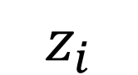
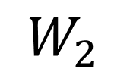
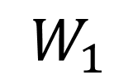
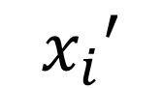
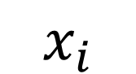
PCA as a Neural Network
$$x_{i}$$
$$x_{i}′$$
$$W_{1}$$
$$z_{i}$$
$$W_{2}$$
Notes:
Hadar
So what comes in mind when thinking about PCA is the closed form analytical solution, but it can also be represented as a shallow (single layered ) linear neural network (w.o. activations) where the weights will eventually converge to the PCA matrix (which is the optimal solution in this case). Same goes for the reconstruction stage which is another single-fully connected-layer which practically will be the pseudo-inverse of the PCA matrix.
So the problem with using PCA in our case is that it assumes the points lay on a linear subspace while our natural image dataset is much more complex. So intuitively what we would have wanted is a much more expressive algorithm which has the capacity to handle such a dataset and learn the estimated manifold on which all the points lay.
So effectively what we can do is add more layers and non-linear activations -

Slide 10
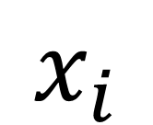
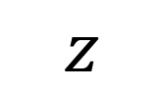
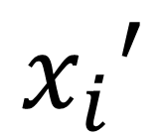
“Non-linear expanded PCA”
$$x_{i}$$
$$x_{i}′$$
$$z$$
Notes:
Hadar
This allow the model to be much more expressive and adaptive to non-linearity of the data. So we can look at this network as having two stages -
In order to improve expressivity, we can add layers and allow them to be non-linear.
This architecture is called –

Slide 11
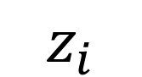
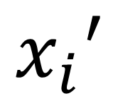
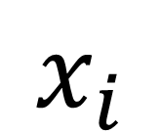
“Non-linear expanded PCA” $≈$AutoEncoder
$$x_{i}$$
$$x_{i}′$$
$$z_{i}$$
E
D
Notes:
Hadar
The “dimensionality reducing stage” which is termed “Encoder”, and the “reconstruction stage” which is called “Decoder”. Each of the stages can have as much layeres as we want, but for each layer in the encoder there’s an equal in the decoder only in reversed order.

Slide 12
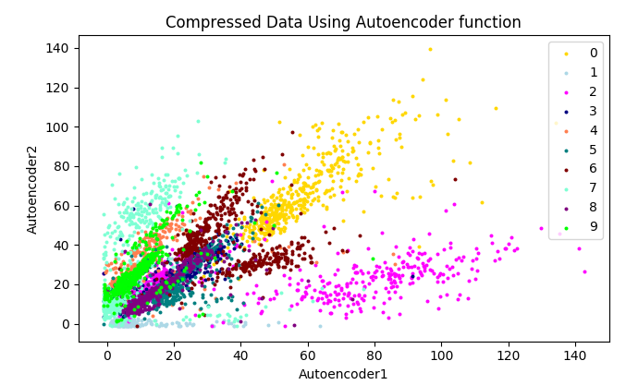
AutoEncoder Clustering
Notes:
Hadar
Let’s go back to the examples we’ve seen previously – when looking at the representation of MNIST dataset in R2 after applying PCA, we can see that the digits are quite clustered but the clusters are overlying one another. However, when looking at the representation of a trained encoder, the clusters are almost entirely separated from one another, meaning the encoder was able to learn inner-complex features of the images where PCA couldn't.

Slide 13
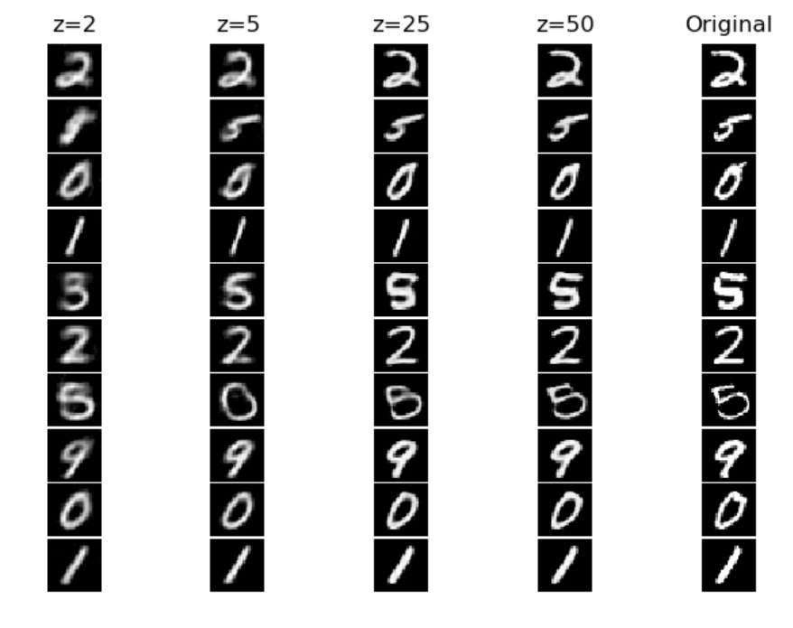
Reconstruction with AutoEncoder
PCA
AE
Notes:
Hadar
Now let’s look at the reconstructed images rather than their latent representation. We can see that when using PCA with latent space of lower than 25 we almost lose all of characteristics of the images to the point they all look the same. On the other hand, the trained autoencoder did a wonderful job at preserving the core features of the images so that even when reducing to 2d vectors, we can still recognize the digits and the images look quite similar to the originals. So one of the hidden concepts here is to realize that each image has an intrinsic dimensionality which is the actual dimension of the data. In the case of MNIST, we see very beautifully that the dimension is close to 2 as we see in the AE results, but still non-linear because PCA wasn’t able to learn properly the features.

Slide 14
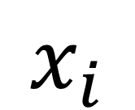
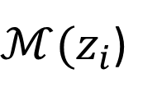

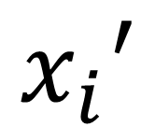
“DP” AutoEncoder
$$x_{i}$$
$$x_{i}′$$
$$z_{i}$$
$ℳ(z_{i}$)
E
D
Notes:
Roy

Slide 15
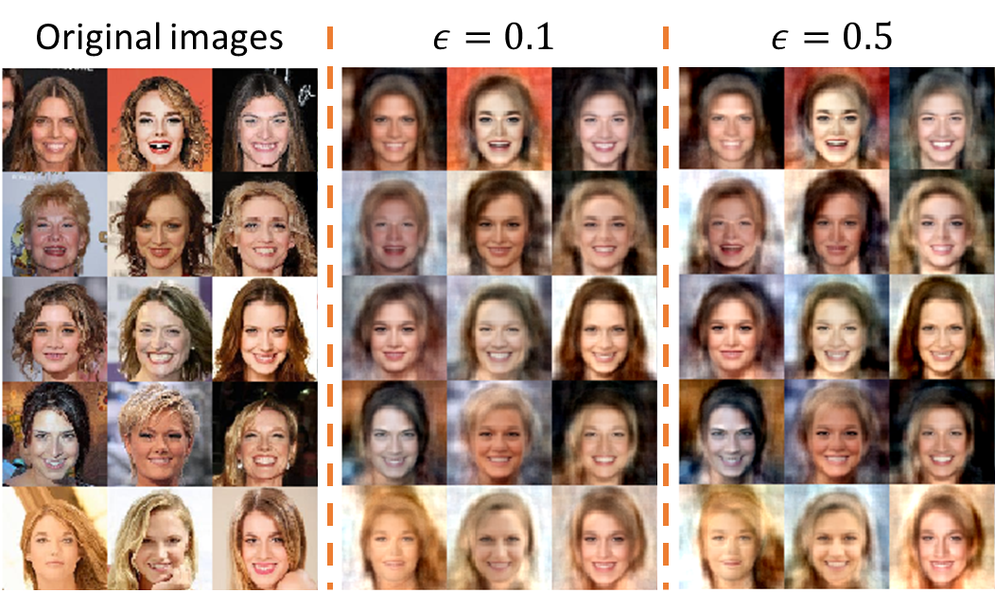
Noising Features – PCA example
Notes:
Roy

Slide 16
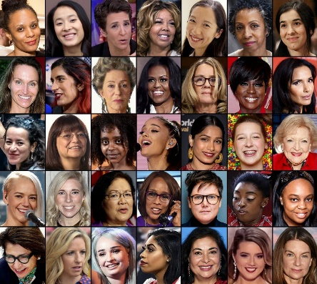
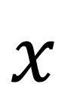
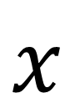
Project Outline
$$x$$
$$x$$
E
D
Notes:
Roei

Slide 17

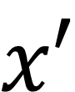
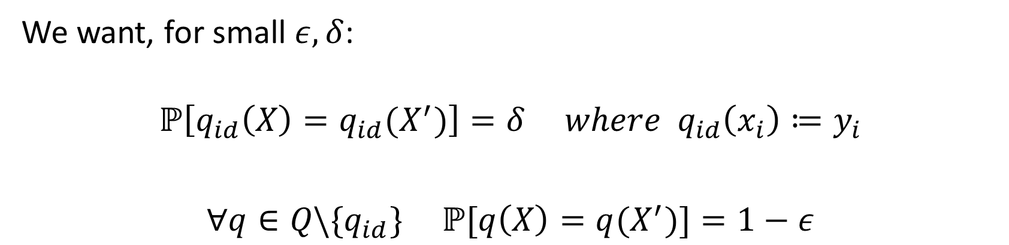
Project Outline
$$x$$
$$x′$$
E
D
We want, for small $ε,δ$:
$${ℙ\left[q_{id}\left(X\right)=q_{id}(X^{′})\right]=δ where q}_{id}\left(x_{i}\right)≔y_{i}$$
$∀q∈Q\backslash \{q_{id}\} ℙ[q\left(X\right)=q(X^{′})]=1−ε$
Notes:
Roei

Slide 18
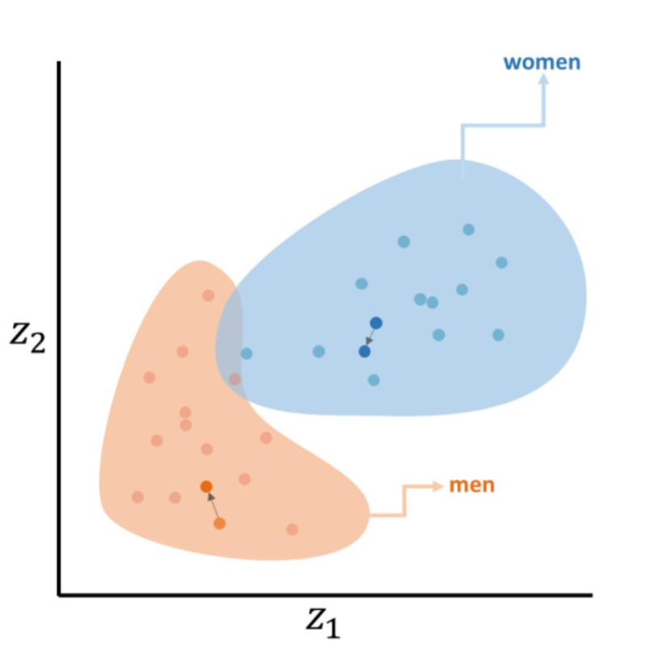
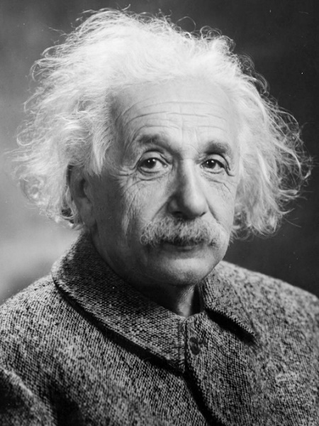
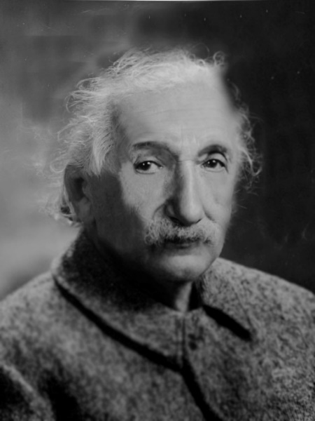
Performance Evaluation in our Project
Empirical evaluation
As usual, two metrics of interest:
Privacy – represented by loss of identity
Accuracy – most statistics remain the same
Is_Einstein_conf = 0.97
Is_Einstein_conf = 0.24
Notes:
Roei
Focusing on performance evaluation in our project– showing theoretical bounds will be very difficult but we came up with a number of empirical tests that are straightforward and which we think are convincing.
As always, we would like to quantify the loss of privacy and the loss of accuracy. In the examples we have shown, privacy comes from the loss of the identity of the person in the picture.
So we are drafting a test where we use a state-of-the-line face recognition NN to check how well it recognizes the identities of the noised images in X’.
On the other side we want to measure accuracy, and here, accuracy is a measure of how similar the statistics remain before and after applying our mechanism.
- encodings statistics remain the same (clusters means and stds)
And we hope this would translate into
- queries remain the same

